Slide 1

On Diuresis
PGR 3/4/21

Slide 2
On Diuresis
Brian Locke, MD
PGR 3/4/21

Slide 3
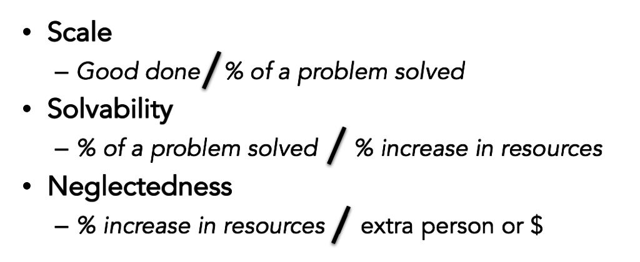
Criteria to evaluate the potential impact of work in an area
Notes:
Choosing a teaching topic that has the most potential to be useful:
-widely applicable
-and improvable
-neglected

Slide 4
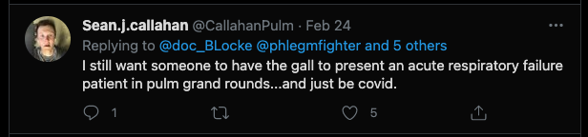
Criteria to evaluate the potential impact of a line of inquiry

Slide 5
Case Presentation
51M with COPD (FEV1 55% predicted, F/F 67% predicted), morbid obesity, T2DM, HFpEF, untreated severe OSA, pulmonary hypertension (mPAP 40, PCWP 15) and chronic hypercarbic and hypoxemic respiratory failure (4L), and alcohol+nicotine use d/o’s
Presented with abdominal and scrotal edema over 1-2 weeks
VS: T 37.0C, HR 118, Resp 20, BP 166/85, 95% on 5L O2, BMI 55.7
Admitted to medicine. Diuresed 1-2L daily. Not getting out of bed.
“Suspect near euvolemia due to contraction alkalosis”
Transferred to MICU 3 days into hospitalization due to hypoxemia requiring HFNC 70%.
Notes:
”Hypervolemia may be due to increased fluid intake” - admission H&P. not unless GFR is LOW

Slide 6
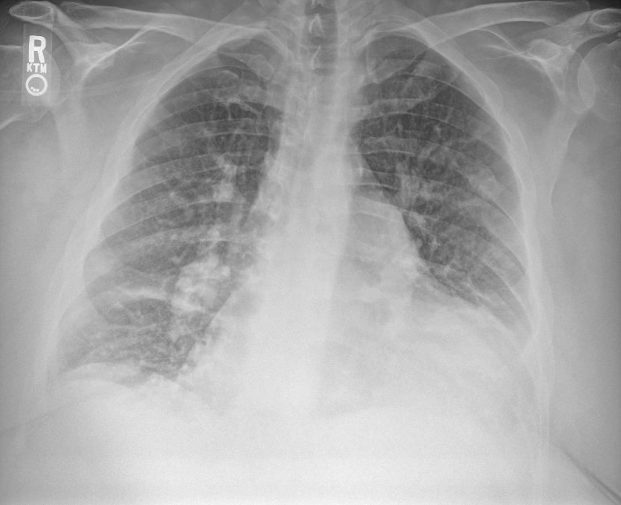
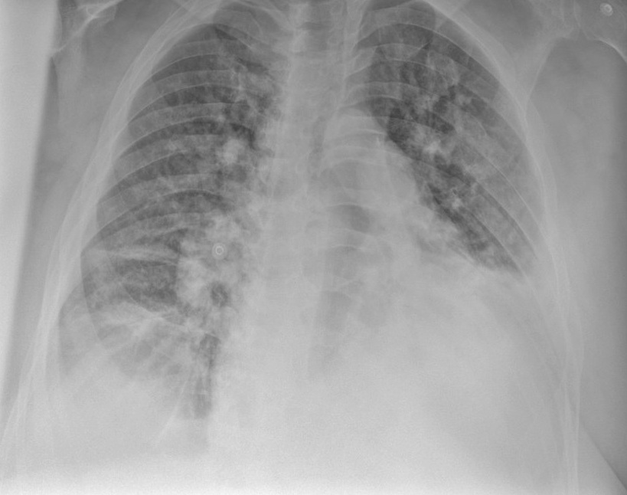
Admitted to ICU
In ED: CBC normal except macrocytosis 102.3. CMP normal except CO2 40 (sCr 0.77)
On transfer to ICU: 7.43 / 80.5 / 71 on 15L. Measured HCO3 45
TTE shows RVSP 69, dilated 3.4 cm IVC. RV enlargement (RVIDD 6cm) with maintained contractile function (TAPSE 2.1cm). LV relatively normal left side function and filling pressure. No shunt by bubble.

Slide 7
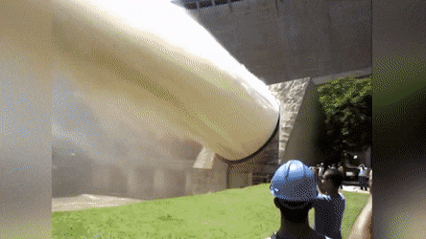
Diagnosis: Acute on Chronic Hypercapneic and Hypoxemic Respiratory Failure
Major Malfunction: Congestion
What do we do now?
Notes:
how many patients are present in our ICUs at any given time who are diuresing for frank hypervolemia, whether iatrogenic or their reason for admission?

Slide 8
“Despite hospitalization for HF being exceptionally common, expensive, and morbid, we have not a single Class I Level of Evidence: A guideline recommendation to guide our care of these patients”
Notes:
https://www-sciencedirect-com.ezproxy.lib.utah.edu/science/article/pii/S0735109720381031
Notably, in the ADHERE (Acute Decompensated Heart Failure National Registry), ∼20% of patients were discharged with no weight loss or even weight gain

Slide 9
“Despite hospitalization for HF being exceptionally common, expensive, and morbid, we have not a single Class I Level of Evidence: A guideline recommendation to guide our care of these patients”

Slide 10
A brief review of pathophysiology of congestion
Kidneys are under-perfused (Decreased EABV)
Na delivery to macula densa decreases
RAAS activity increases (‘neurohormonal activation’) and Na absorption is increased as the kidneys mistakenly interpret underperfusion as hypovolemia
ECF fluid expansion (interstitial and intravascular) and edema occurs.
If hypoperfusion is profound enough, the body releases ADH to sacrifice tonicity (Na) to maintain volume, and hyponatremia can develop
Notes:
Differences between ESRD, Cirrhosis, and CHF (either HFrEF, HFpEF, or R Heart Failure)
“High creatinine does signify it will be a more complex diuresis”. With a relatively normal creatinine, drinking fluids will never lead to hypovolemia – a key point for this talk, as we will focus on the reverse case
“Low Na on admission is a predictor of both all-cause mortality and cardiovascular mortality for patients admitted with a heart failure exacerbation
A drop in sodium levels of >3 mEq/L was associated with increased mortality. Risk of death was particularly worse for Na <125 in heart failure exacerbations”
Congestion is not caused by excess fluid intake
Congestion is caused by excess Na retention
Congestion is not solved by fluid output
Congestion is solved by natriuresis
Does fluid output temporize?
Not sure…

Slide 11
4 Issues in Diuresis, revisited
How Do We Arrive at a Loop Diuretic Dose?
What else can we do to help?
How Do We Arrive at a goal?
How do we know when to stop?

Slide 12
How do you choose your initial Lasix dose?
Home dose * 2.5 and IV (DOSE trial)
1 mg/kg IV Lasix
Age + BUN = Lasix dose
Doesn’t matter, just make sure you adjust

Slide 13
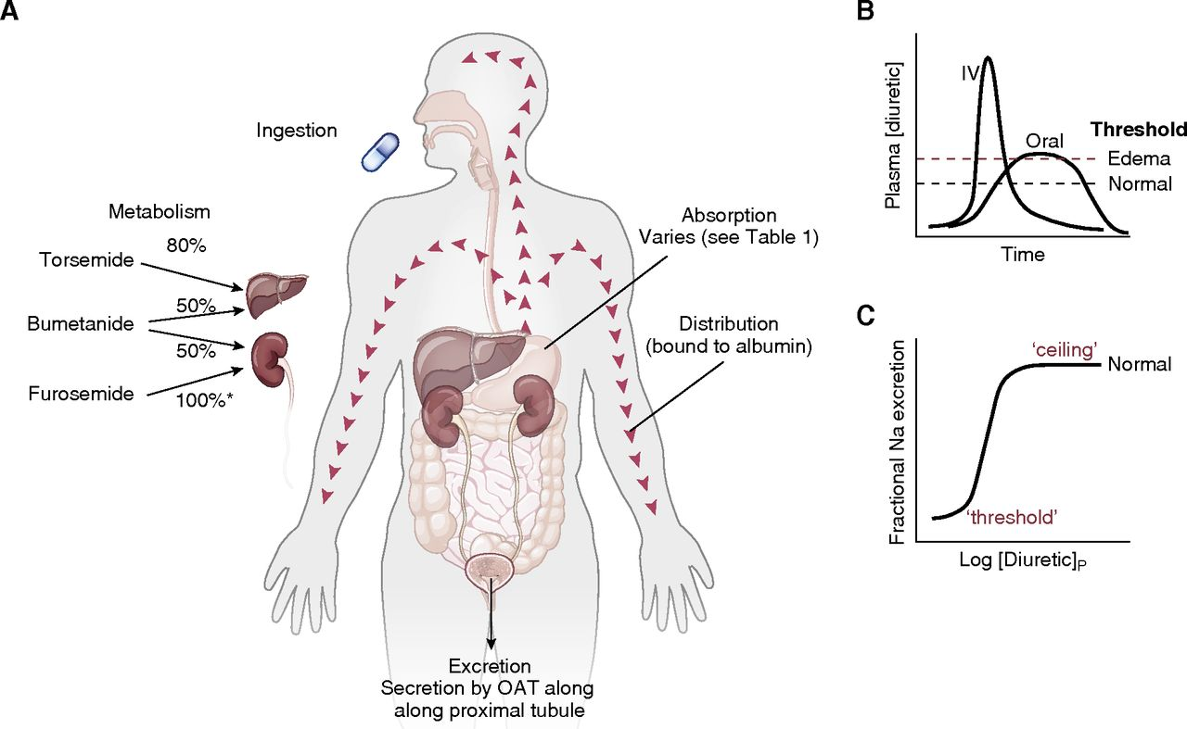
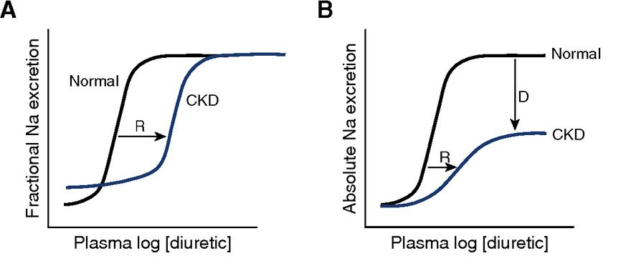
Furosemide Pharmacokinetics
Act from LUMEN of nephron on thick ascending limb of Loop and macula densa.
Natriuretic threshold ~
GFR (delivery)
Vd (increased in hypoalb)
Notes:
https://cjasn.asnjournals.org/content/14/8/1248#sec-4 CJASN 14: 1248–1257, 2019. doi: https://doi.org/10.2215/CJN.09630818.
Furosemide is secreated in tubule lumen (not filtered due to being protein bound).
This process is inhibited by NSAIDs

Slide 14
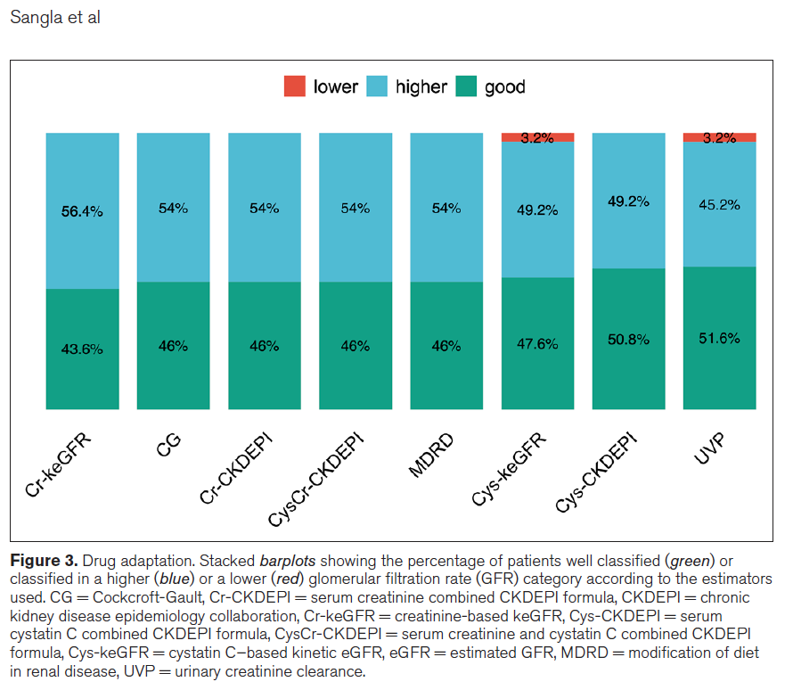
GFR estimate in Critical illness
Predictive equations compared to iohexol dose derived GFR measurement in unselected ICU patients
Kinetic and creatinine clearance measurement are BOTH still off
not just lack of steady state.
Notes:
Sangla, F., Marti, P. E., Verissimo, T., Pugin, J., de Seigneux, S., & Legouis, D. (2020). Measured and Estimated Glomerular Filtration Rate in the ICU: A Prospective Study. Critical Care Medicine, 48(12), e1232-e1241.

Slide 15
N of 1 Trial
Due to unpredictability – very difficult to predict ahead of time
Wait 6 hours? Lasix duration of action is actually shorter
Last six hours = depends on ”absorption limited pharmacokinetics”.
Shorter in IV
Wait 2 hours for a response
Give a dose. If no response in 2 hours, double the dose.

Slide 16
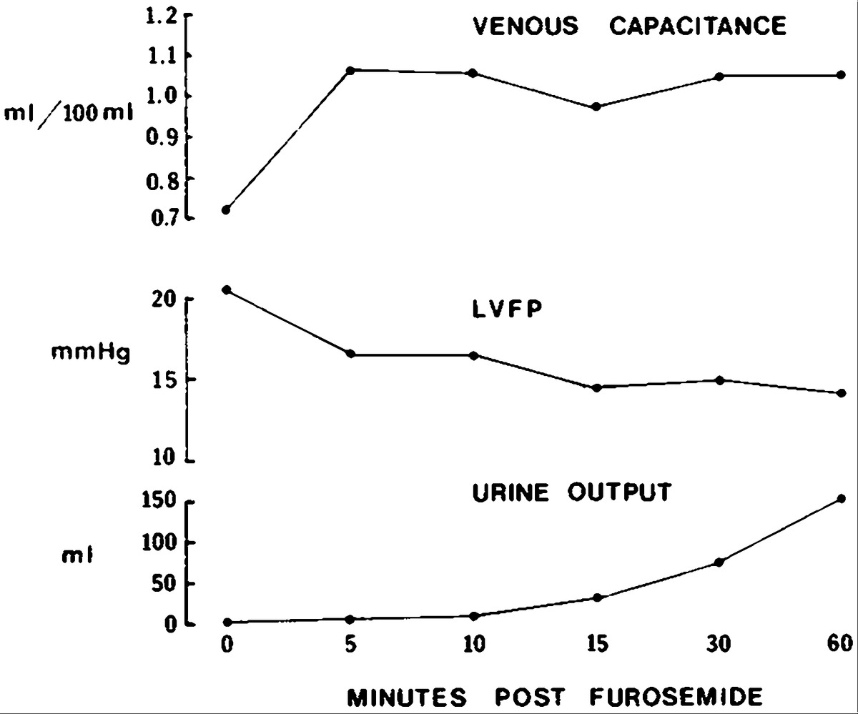
Loop diuretic physiology – symptoms not sufficient to guide decongestion
Furosemide reduces preload immediately due to venodilation – before diuretic effect starts.
Temporal Changes in Mean Left Ventricular Filling Pressure, Calf Venous Capacitance, and Total Urine Output after Intravenous Furosemide. Dikshit K et al. N Engl J Med 1973;288:1087-1090
Notes:
Figure 3. Temporal Changes in Mean Left Ventricular Filling Pressure, Calf Venous Capacitance, and Total Urine Output after Intravenous Furosemide. The decrease in left ventricular filling pressure within the first 15 minutes is accompanied by a simultaneous increase in calf venous capacitance, during which there was insignificant urine output. At one hour there was, in addition, a significant volume diuresis that may further have reduced intravascular volume.

Slide 17
Toxicity without volume depletion?
1985: Patient with oliguric AKI were given “1 g furosemide was given as a single injection over four hours. In the test group, frusemide was then continued either intravenously or orally in a dose of 3 g/24 hr until a urine output of 200 ml/hr was sustained or until the plasma creatinine fell …The serious complication of deafness occurred in two of 28 patients and in one of them this was permanent.”
2021: Yale Diuretic Protocol: “automated, nurse-driven, and called for administration of 2 to 12.5 mg IV bumetanide up to 3 times daily.” “rapidly escalated toward a peak of 1,500 mg IV furosemide equivalents per day that was reached in the first 2 days of the protocol in 86% of patients.” “No cases of ototoxicity (n=409)
Meta-analysis: OR 3 of developing ototoxicity when dose excess 1 GRAM daily (~40 mg/hr)
NOT A NEPHROTOXIN
Notes:
https://journals.sagepub.com/doi/10.1177/00369330740190S108
“In the Yale Diuretic Protoco (JACC 2021)l: used primarily in folks with diuretic resistance. The protocol was automated, nurse-driven, and called for administration of 2 to 12.5 mg IV bumetanide up to 3 times daily. With initiation of the YDP, diuretic dosing was rapidly escalated toward a peak of 1,500 mg IV furosemide equivalents per day that was reached in the first 2 days of the protocol in 86% of patients. In 84% of cases, the YDP was terminated for satisfactory reasons (i.e., discharge, euvolemia, addition of thiazide diuretic, and transition to standing dose 12.5 mg bumetanide 3 times daily). The remaining 16% of patients had the YDP terminated for unfavorable reasons (e.g., worsening renal function); yet, the risk of electrolyte abnormalities, hypotension, and worsening renal function were similar pre- and post-initiation of YDP.”

Slide 18
4 Issues in Diuresis, revisited
How Do We Arrive at a Loop Diuretic Dose?
What else can we do to help?
How Do We Arrive at a goal?
How do we know when to stop?

Slide 19
What other initial orders are important?
Strict I/Os and Daily weights? Yes or No
Fluid restriction of 2L per day? Yes or No
Na restriction of 2g per day? Yes or No

Slide 20
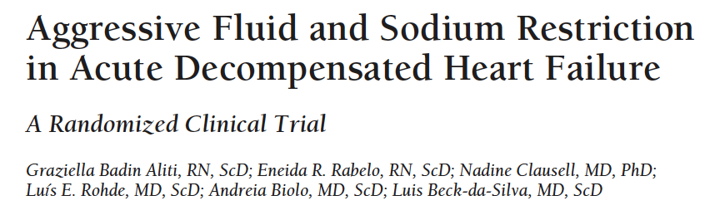
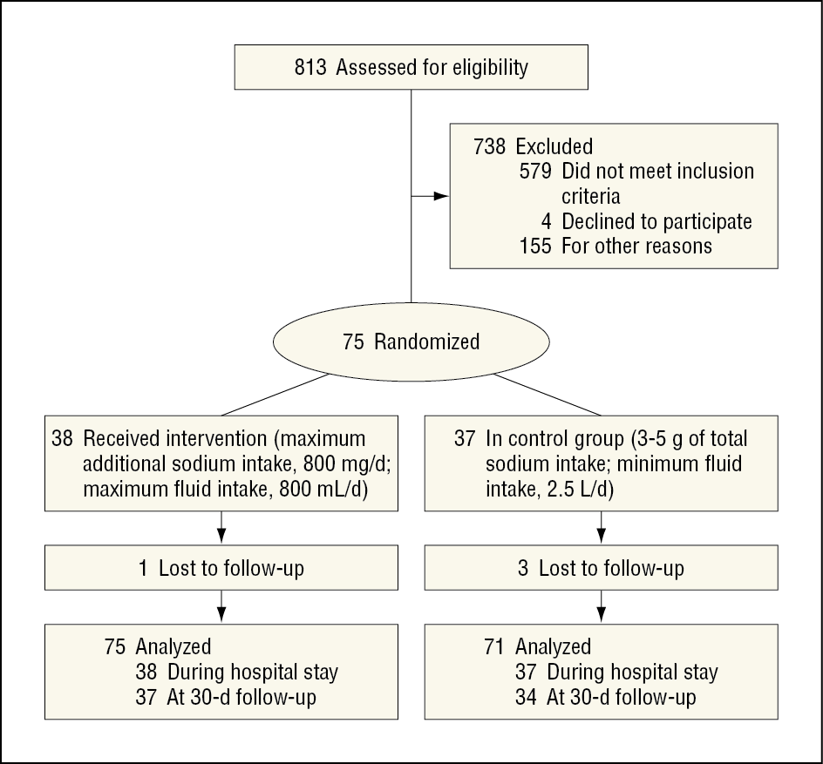
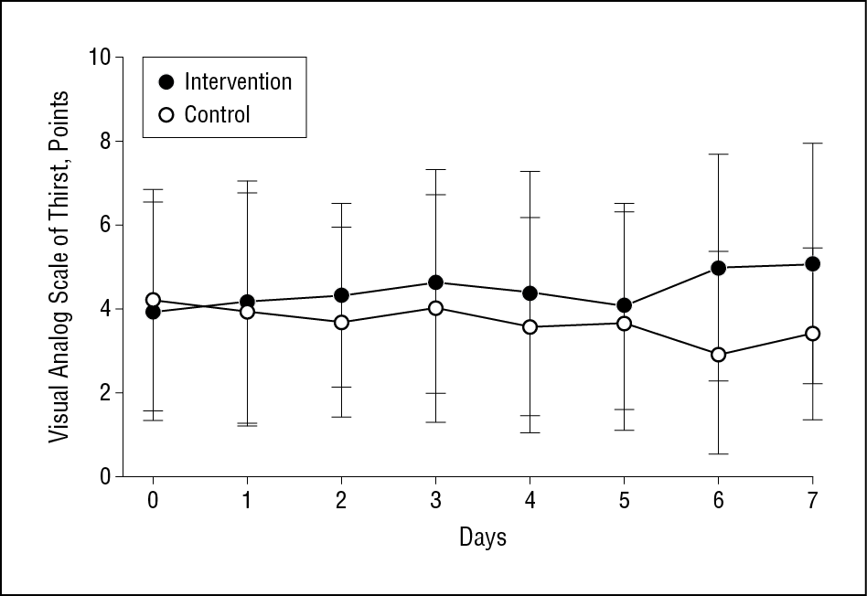
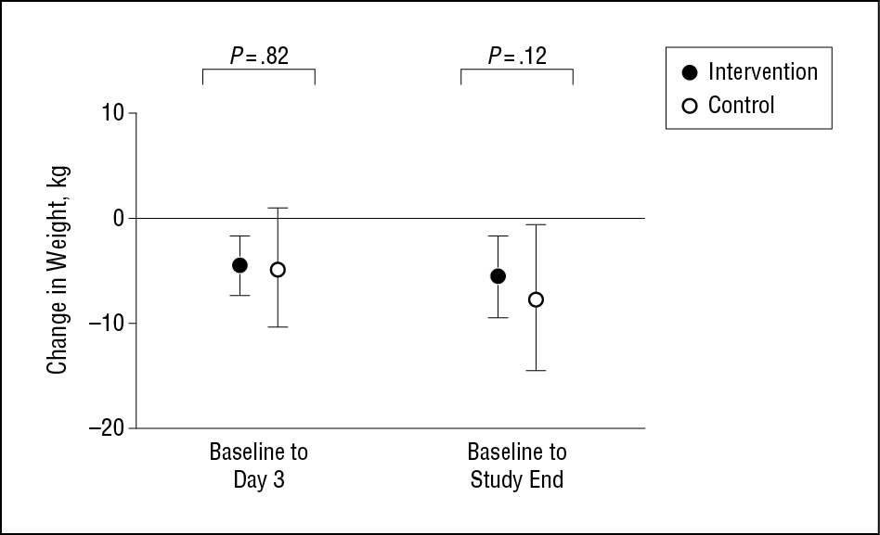
Salt and Fluid Restriction
Notes:
“The recommendations for dietary salt intake in patients with heart failure vary from “moderate sodium restriction” to less than 2 to 4 g/d, frequently with fluid restriction to less than 2 L/d.⁴ These levels are paradoxically frequently greater than the 1500 mg/d of salt recommendation of the American Heart Association and the Institute of Medicine for the general population, but less than the salt intake in the general population, and are mostly based on expert consensus rather than as a result of multiple randomized trials.”
And in fact, may be harmful in long-term: https://pubmed.ncbi.nlm.nih.gov/26738949/ . Analagous to current age where the body’s response to perturbed physiology is the actual culprit.

Slide 21
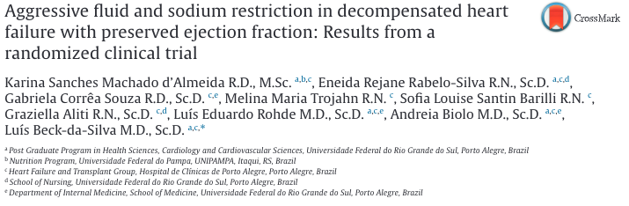
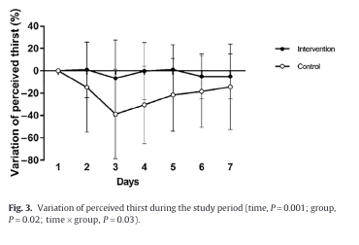
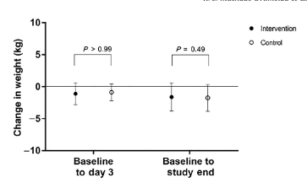
Salt and Fluid Restriction causes… thirst

Slide 22
4 Issues in Diuresis, revisited
How Do We Arrive at a Loop Diuretic Dose?
What else can we do to help?
How Do We Arrive at a goal?
How do we know when to stop?

Slide 23
What is your goal in the next 24 hours?
The intern suggests 40 IV Lasix. You suggest first coming up with a goal first, then a dosing strategy to meet that goal:
2-3L net negative in the next 24h
2-3 kg negative in the next 24h
100 mmol Na negative in the next 24h
3+ L net negative in the next 24h
3+ kg net negative in the next 24h
150 mmol Na negative in the next 24h
Notes:
(3-5L daily was target in DOSE trial)

Slide 24
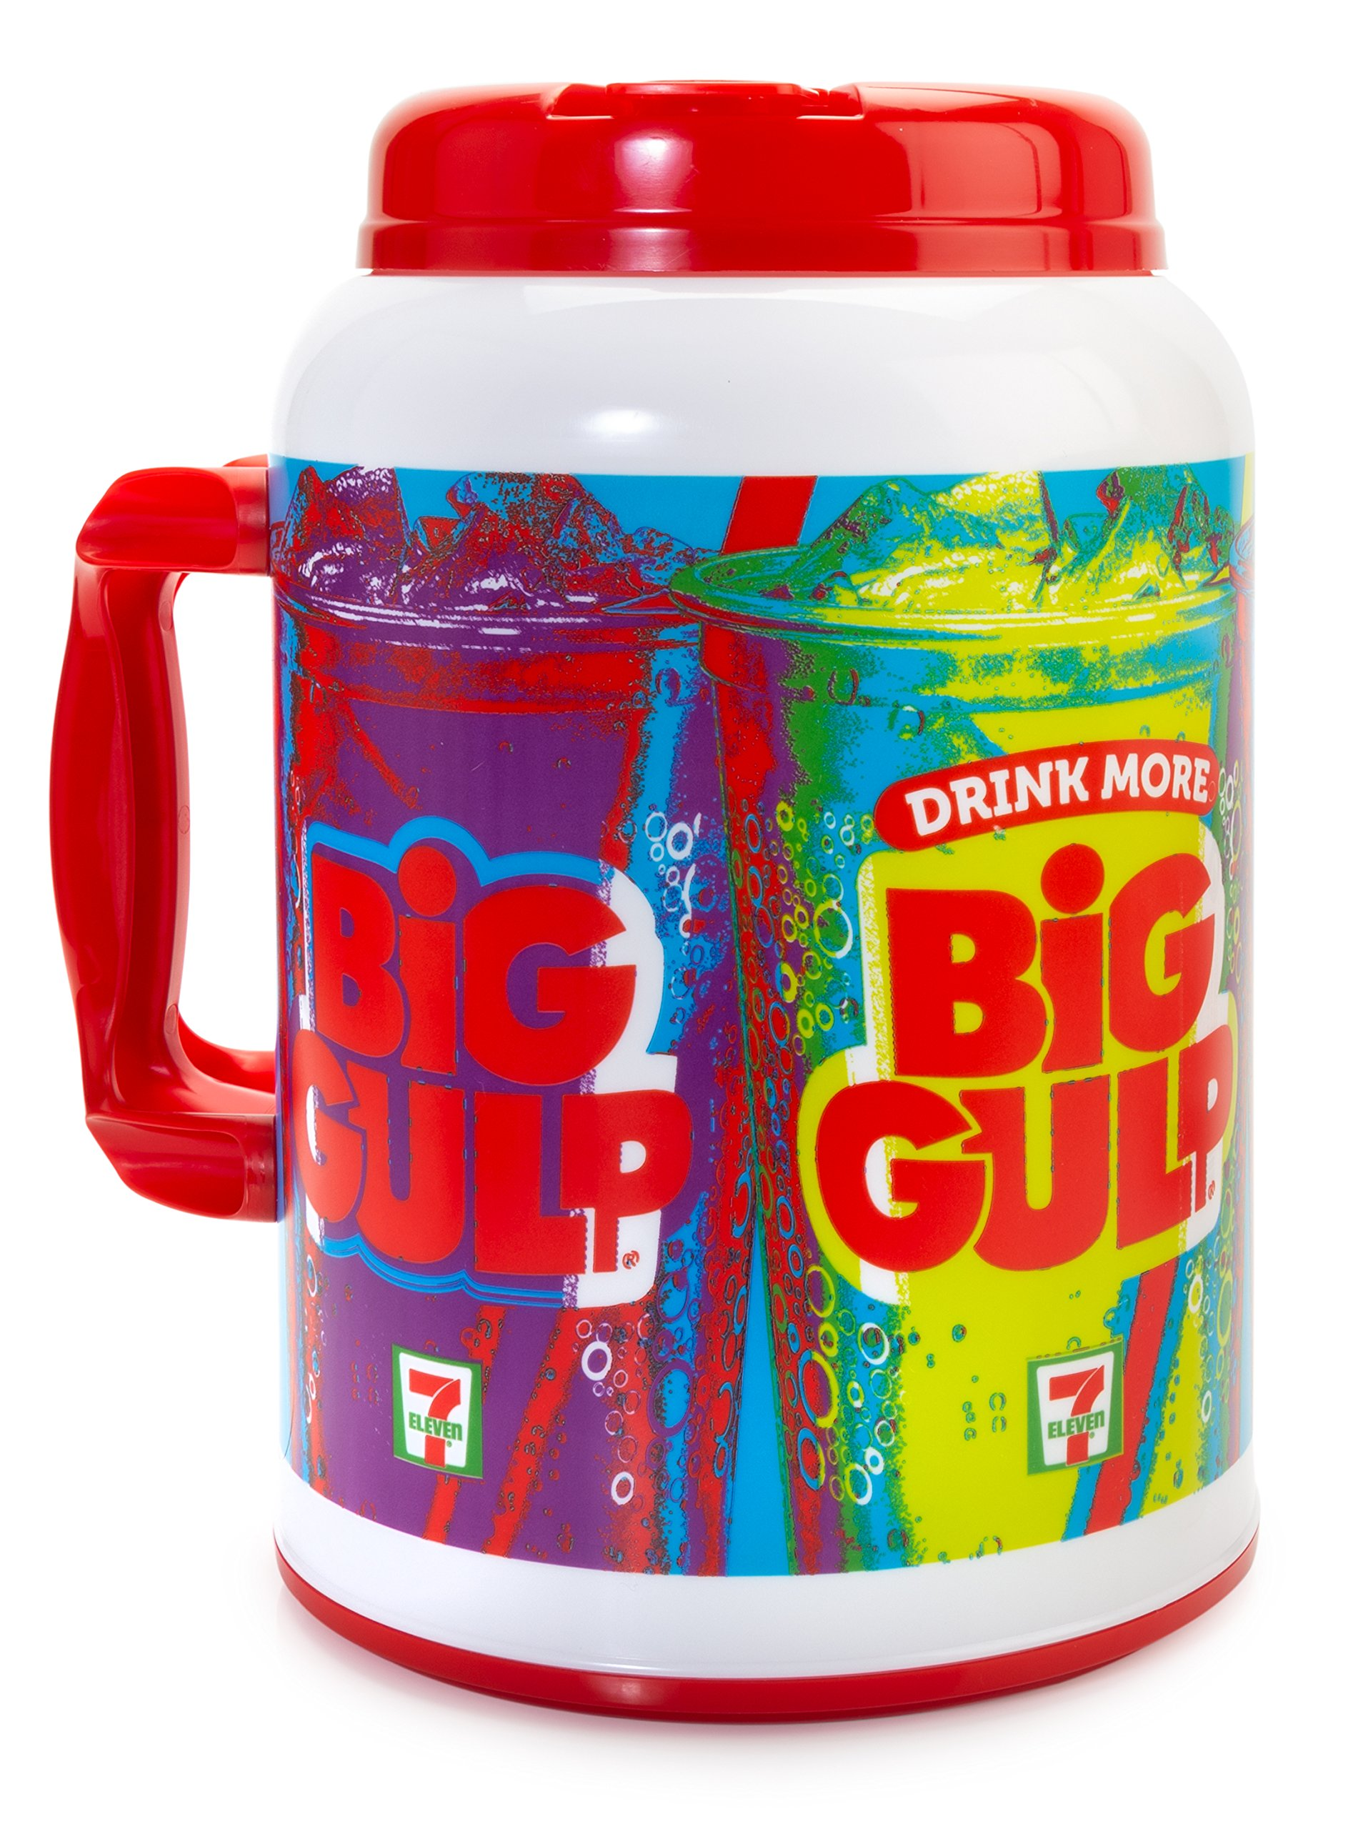
Return to case:
We relaxed his fluid restriction and he drank 5L, made 5L of urine with no weight change.
Did we just waste a day?

Slide 25
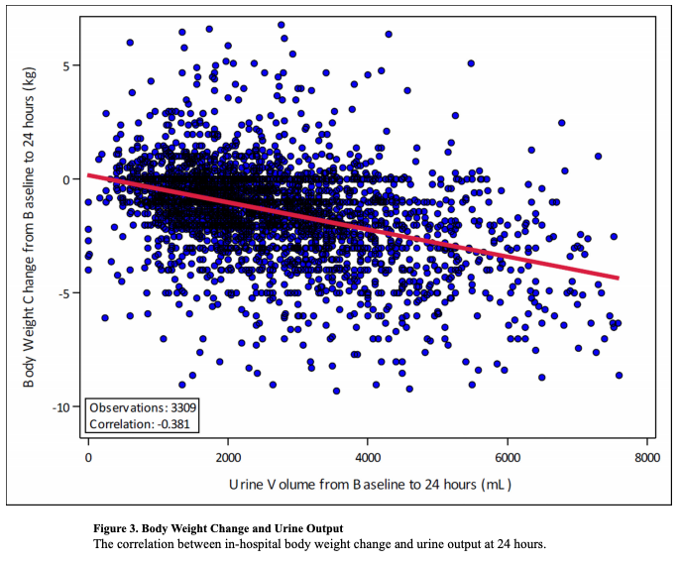
What is the problem with I/O and Kg?
Resource intensive (charting I/Os)
Inaccurate
It’s a surrogate for Natriuresis
Depends in a constant U_Na concentration
Assumptions
Mmol Natriuresis (what we care about)
<–concentration of UrineNa-->
volume of Urine
<–weight or tracking recording-->
change (what we act on)
Notes:
“Fluid overload may be due to … increased fluid intake” – reverse is also not true
“typical clinician orders for “strict ins and outs,” accurate data in real-world practice can be challenged by inconsistent patient compliance and the burden of collecting these data on nursing staff”
ASCEND-HF correlation between I/O and Kg change

Slide 26
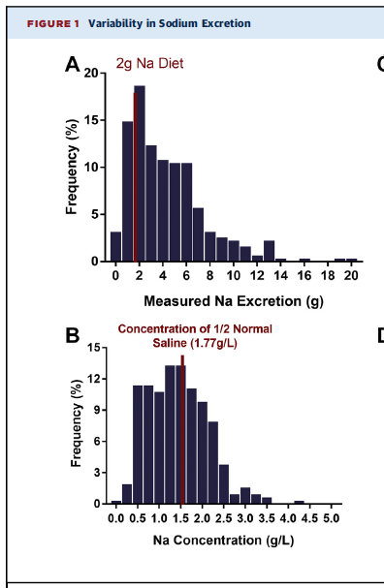
Natriuresis varies widely during diuresis
Why might the Na concentration of urine vary between patients?
Depends on ADH presence (among other other reasons).
Tight water restriction = ADH increase, natriuresis unchanged.
Loose water restriction = ADH decrease, natriuresis unchanged
Notes:
From Rao 2021

Slide 27
Urine composition by time
“the sodium content of diuretic-induced urine is highly variable and correlates only modestly with fluid and weight loss”
Notes:
https://www.ahajournals.org/doi/full/10.1161/circheartfailure.114.001377
Patients with HFrEF presenting with congestion and requiring IV diuretic. Many received spironolactone and thiazide as well.
Left = volume, middle = Na, right = ratio aka concentration.
(bottom shows that differences are attributable to de-escalating doses)
urinary composition during decongestive treatment is characterized by a progressive decrease in urinary Na⁺ and Cl⁻ excretion, even after correction for diuretic dose
Urine output was substantially higher during the first (2700 mL [1900–3450 mL]) when compared with that during the second (1550 mL [1006–2075 mL]) or third (1375 mL [1200–2200 mL]) 24-hour intervals -> primarily due to decrease in dosing.
=> Impact = Natriuresis resistance is probably even higher than diuretic resistance, and we wouldn’t necessarily know based on I/O tracking.

Slide 28
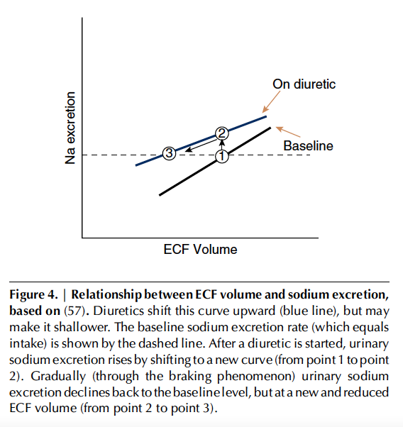
Braking Phenomenon (of natriuresis)
Assume a patient makes no dietary changes
Sodium clearance increases with ECF (true)
Off diuretics, a patient takes in 3g of Na in 24h. They are at steady state. 3g of Na must be excreted in 24h. They are congested.
If you start a diuretic, initially their ECF is unchanged (congested), but natriuresis increases.
They eventually reach a new steady state (in=out), but at a lower ECF
Notes:
Ellison, D. H. (2019). Clinical pharmacology in diuretic use. Clinical Journal of the American Society of Nephrology, 14(8), 1248-1257
“Diuretics are recommended universally to treat symptomatic ECF volume expansion, with rare exceptions, and therapeutic success is considered to be reduction in ECF. This invariably requires initial sodium and water losses, induced by diuretic doses that exceed the threshold (Figure 4). Yet the situation
changes as initial treatment moves toward successful chronic treatment. At any therapeutically active dose, natriuresis wanes as ECF declines, an effect often called the “braking phenomenon” (58). This means that, at steady state, the individual returns to NaCl balance, during which urinary NaCl excretion
is equal to dietary NaCl intake once again. This occurs, however, at a lower ECF volume than before treatment.”
2gm of 24h intake = 2 gm 24h output once at equilibrium
If you start diuretics -> NaCl excretion will eventually equilibrate with NaCl intake, but at a lower ECF volume. This decrease is caused the breaking phenomenon. This starts to occur immediately, and explains why the U_Na concentration decreases as you go on. This is mediated by the sympathetic nervous system (e.g. RAAS), and is maladaptive if it occurs before euvolemia has been restored.

Slide 29
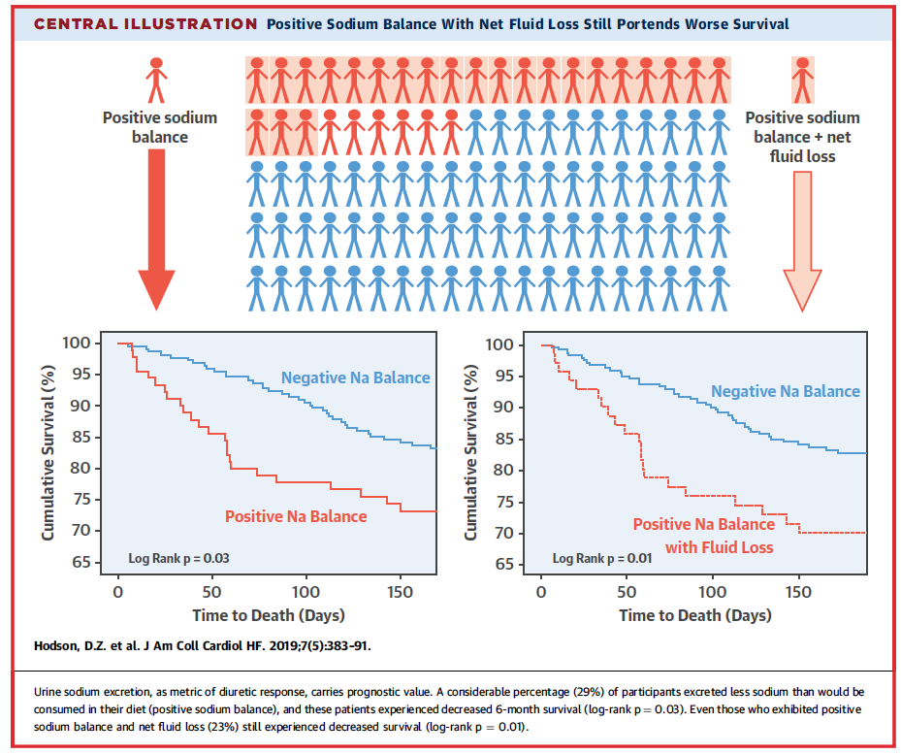
Discordant Diuresis and Natriuresis
 | Net Na drops a little | Net Na drops a lot
Net I/O drops a little | Not much response, normal [U_Na] | Good natriuresis, high [U_Na]
Net I/O drops a lot | Good diuresis, Low [U_Na] | Good response, normal [U_na]
Notes:
Hodson, D. Z., Griffin, M., Mahoney, D., Raghavendra, P., Ahmad, T., Turner, J., ... & Testani, J. M. (2019). Natriuretic response is highly variable and associated with 6-month survival: insights from the ROSE-AHF trial. JACC: Heart Failure, 7(5), 383-391.
However, total urine output (adjusted HR/l: 0.93; 95% CI: 0.77 to 1.11; p . 0.43), net fluid balance (adjusted HR/l: 0.98 (95% CI: 0.83 to 1.17; p . 0.87), and weight loss (adjusted HR/kg: 0.94; 95% CI: 0.85 to 1.04; p . 0.25) were not significantly associated with survival.
So what if you loosen up water restriction, I/O = negative but net natriuresis is achieved?

Slide 30
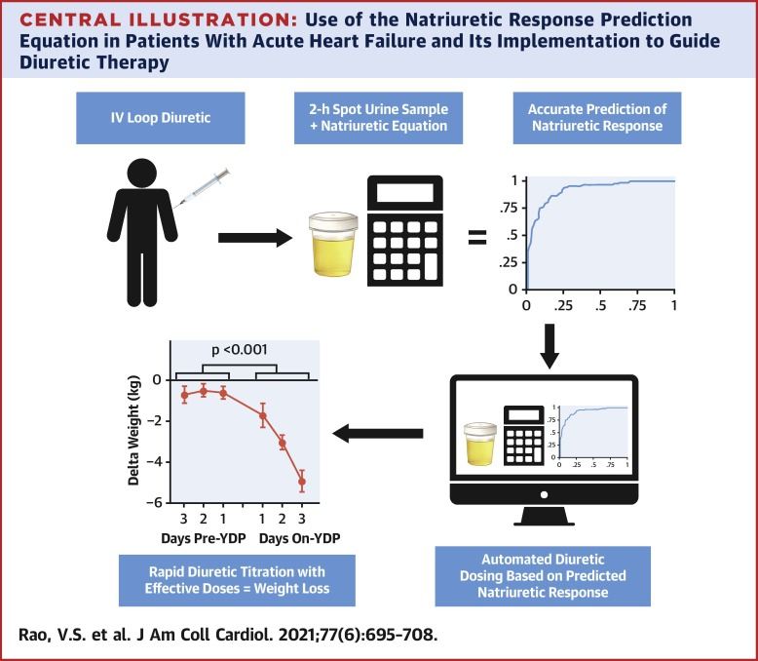
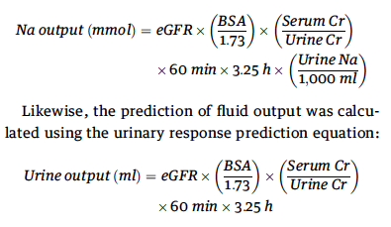
Natriuresis based decongestion
Simple: Spot urine Na > 100 2h after dose = was probably effective (will lead to net 2g+ natriuresis in BID dosing)
Complex:
Notes:
https://pubmed.ncbi.nlm.nih.gov/33573739/

Slide 31
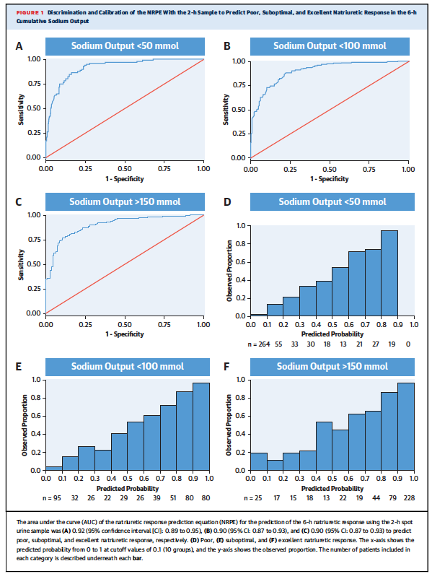
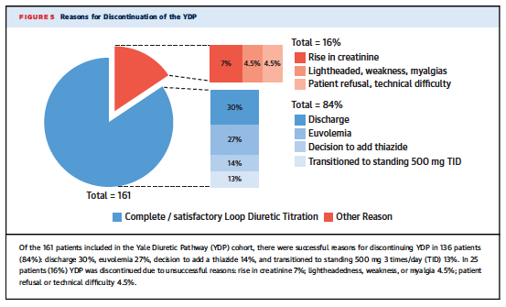
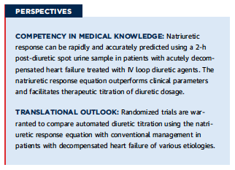
Does it work?
NCT04481919 RCT with hard outcome end-points ongoing
Notes:
Within the 6-h cumulative collection, spot urine samples were obtained at hours 1, 2, and 6. Compared with the reference value of the directly measured 6-h cumulative sodium output, the NRPE using spot urine sodium and creatinine values 2 h following diuretic administration showed exceptional discrimination for poor, suboptimal, and excellent natriuretic responses, with areas under the curve ranging from 0.90 to 0.92.
Similarly, the NRPE was strongly predictive of cumulative sodium output, outperforming a series of other measures including net fluid output, spot urine sodium, and the fractional excretion of sodium.
https://twitter.com/ebtapper/status/1363237759192870913 Steps: 1. Predict diuresis using urine sodium 2. Protocolize diuretic dosing 3. Help patients with CHF feel better fast led by Dr. Veena Rao”
We applaud the investigators for pursuing a blinded randomized trial (NCT04481919).

Slide 32
4 Issues in Diuresis, revisited
How Do We Arrive at a Loop Diuretic Dose?
What else can we do to help?
How Do We Arrive at a goal?
How do we know when to stop?

Slide 33
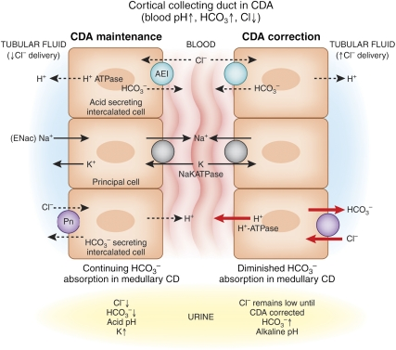
“Suspect near euvolemia due to contraction alkalosis”
Loop diuretics create Chloride (and Sodium)-Rich urine
Loosing Cl- rich, ‘bicarbonate poor’ urine will lead to development of alkalosis at ANY extracellular volume.
Pendrin: Chloride – Bicarbonate exchanger to maintain neutrality
Not “contraction” (albumin will not fix it), but “chloride depletion” (saline will).
Notes:
Luke, R. G., & Galla, J. H. (2012). It is chloride depletion alkalosis, not contraction alkalosis. Journal of the American Society of Nephrology, 23(2), 204-207.

Slide 34
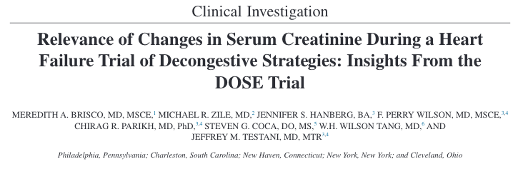
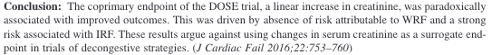
Diurese until sCr clearly increases
Notes:
In fact, post hoc analyses of large trials suggest that those who experience a moderate increase in creatinine (worsening kidney function) may actually have better prognosis than those who do not (55,56).
Survival plots of the risk of death, rehospitalization, or emergency department visit by stable, worsening, or improvement in renal
function. WRF and IRF were defined by >0.3 mg/dL change in serum creatinine (A) and a ≥20% change in eGFR (B). Patients who did
not meet criteria for WRF or IRF were classified as having Stable
RF. IRF, improvement in renal function; RF, renal function; WRF:
worsening renal function.
Brisco MA, Zile MR, Hanberg JS,Wilson FP, Parikh CR, Coca SG,
Tang WH, Testani JM: Relevance of changes in serum creatinine
during a heart failure trial of decongestive strategies: Insights from
the DOSE trial. J Card Fail 22: 753–760, 2016
Another study showing the same
Ahmad T, Jackson K, Rao VS, TangWHW, Brisco-BacikMA, Chen
HH, Felker GM, Hernandez AF, O’Connor CM, Sabbisetti VS,
Bonventre JV, Wilson FP, Coca SG, Testani JM: Worsening renal
functioninpatients with acute heart failure undergoing aggressive
diuresis is not associated with tubular injury. Circulation 137:
2016–2028, 2018

Slide 35
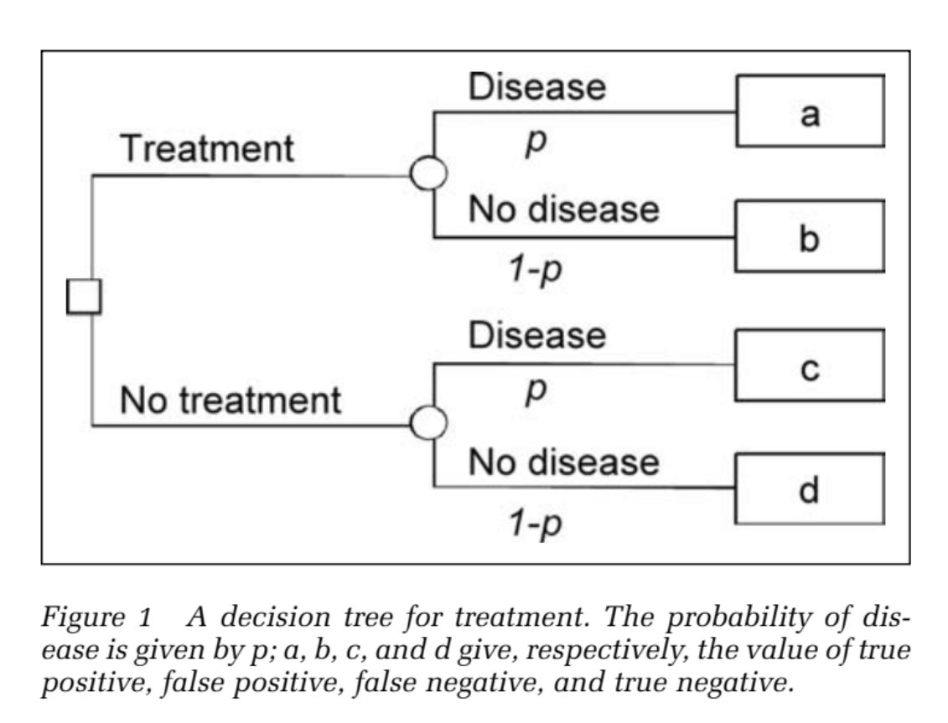
Decision Tree
Is this patient still decongested?
Expected value of:
A: win, continue diuresis
B: sCr bump, no long-term harm
C: Early discharge, increased readmission and morbidity
D: win, no diuresis
Thus, our threshold should be very far toward continuing diuresis (treatment)

Slide 36
Case Resolution
Diuresed from 355 lbs to 307 lbs at discharge – did not have symptoms or chemistry evidence of adequate decongestion at this time.
Inpatient mask fit allowed for tolerance of CPAP inpatient, which was continued on discharge.

Slide 37
Take home points:
The numbers we follow give false assurance
Natriuresis is more important than I/O or Kg, which are inaccurate surrogates
Consider a spot urine Na if unsure if diuretic plan is working
Don’t wait 6 hours to redose Lasix if it’s not working. 2h is enough
Fluid (and Na) restrictions probably don’t help us decongest
Give more Lasix
Don’t stop diuresing until it’s OBVIOUS they are dry
Notes:
We do so much diuresing in the ICU,
a little better = cumulatively make a big impact – think of the cumulative amount of time that could be saved by minimizing the (-500 cc in a day) ineffective diuresis we do
Obviously, it’s more complex in patients with multifactorial disease, CKD, flash pulm edema on PAP, in shock for other reasons, etc.

Slide 38
References:
Ellison, D. H. (2019). Clinical pharmacology in diuretic use. Clinical Journal of the American Society of Nephrology, 14(8), 1248-1257
Sangla, F., Marti, P. E., Verissimo, T., Pugin, J., de Seigneux, S., & Legouis, D. (2020). Measured and Estimated Glomerular Filtration Rate in the ICU: A Prospective Study. Critical Care Medicine, 48(12), e1232-e1241.
Brisco, M. A., Zile, M. R., Hanberg, J. S., Wilson, F. P., Parikh, C. R., Coca, S. G., ... & Testani, J. M. (2016). Relevance of changes in serum creatinine during a heart failure trial of decongestive strategies: insights from the DOSE trial. Journal of cardiac failure, 22(10), 753-760.
Ambrosy, A. P., Cerbin, L. P., Armstrong, P. W., Butler, J., Coles, A., DeVore, A. D., ... & Mentz, R. J. (2017). Body weight change during and after hospitalization for acute heart failure: patient characteristics, markers of congestion, and outcomes: findings from the ASCEND-HF trial. JACC: Heart Failure, 5(1), 1-13.
Luke, R. G., & Galla, J. H. (2012). It is chloride depletion alkalosis, not contraction alkalosis. Journal of the American Society of Nephrology, 23(2), 204-207.
Aliti, G. B., Rabelo, E. R., Clausell, N., Rohde, L. E., Biolo, A., & Beck-da-Silva, L. (2013). Aggressive fluid and sodium restriction in acute decompensated heart failure: a randomized clinical trial. JAMA internal medicine, 173(12), 1058-1064.
Verbrugge, F. H., Nijst, P., Dupont, M., Penders, J., Tang, W. W., & Mullens, W. (2014). Urinary composition during decongestive treatment in heart failure with reduced ejection fraction. Circulation: Heart Failure, 7(5), 766-772.
Hodson, D. Z., Griffin, M., Mahoney, D., Raghavendra, P., Ahmad, T., Turner, J., ... & Testani, J. M. (2019). Natriuretic response is highly variable and associated with 6-month survival: insights from the ROSE-AHF trial. JACC: Heart Failure, 7(5), 383-391.
Rao, V. S., Ivey-Miranda, J. B., Cox, Z. L., Riello, R., Griffin, M., Fleming, J., ... & Testani, J. M. (2021). Natriuretic equation to predict loop diuretic response in patients with heart failure. Journal of the American College of Cardiology, 77(6), 695-708.
https://www.coreimpodcast.com/2020/06/24/5-pearls-on-inpatient-heart-failure/
Notes:
https://www.coreimpodcast.com/2020/06/24/5-pearls-on-inpatient-heart-failure/ - Podcase review
https://cjasn.asnjournals.org/content/14/8/1248#sec-4 – Diuretic overview
https://journals.lww.com/ccmjournal/Abstract/2020/12000/Measured_and_Estimated_Glomerular_Filtration_Rate.54.aspx - Measuring GFR
https://www.ncbi.nlm.nih.gov/pmc/articles/PMC5435117/ - Creatinine bump is a good sign
https://www.ncbi.nlm.nih.gov/pmc/articles/PMC5218831/ - Innacuracy of I/O and Weight
https://www.ncbi.nlm.nih.gov/pmc/articles/PMC3269186/ - Chloride Depletion Alkalosis
https://jamanetwork.com/journals/jamainternalmedicine/article-abstract/1689981 – Fluid and Salt Restriction RCT
https://www.ahajournals.org/doi/full/10.1161/CIRCHEARTFAILURE.114.001377 – Urinary Composition
https://www.jacc.org/doi/full/10.1016/j.jchf.2019.01.007 - Natriuresis vs Diuresis predicting survival
https://www.jacc.org/doi/abs/10.1016/j.jacc.2020.12.022 – Natriuresis guided diuresis

